Slide 1
Artificial Intelligence
Lecture 5

Slide 2
Today’s Lecture
MiniMax Algorithm
Alpha Beta Pruning

Slide 3
MiniMax Algorithm
Minimax is a kind of backtracking algorithm that is used in decision making and game theory to find the optimal move for a player, assuming that your opponent also plays optimally.
It is widely used in two player turn-based games such as Tic-Tac-Toe, Chess, etc.
In Minimax the two players are called maximizer and minimizer.
The maximizer tries to get the highest score possible while the minimizer tries to do the opposite and get the lowest score possible.

Slide 4
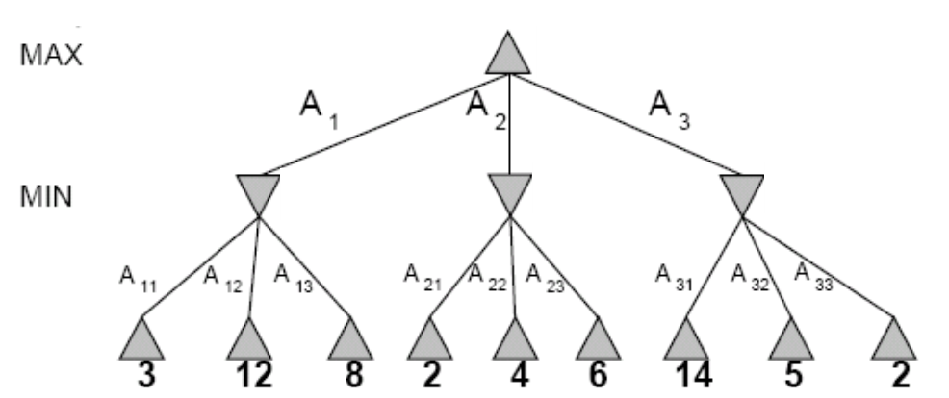
MiniMax Tree

Slide 5
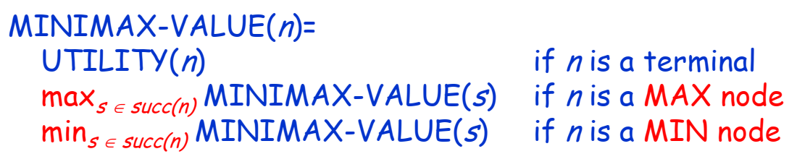
MiniMax Algorithm
Compute for each node n
If n is the terminal node then return utility value
If n is a MAX player’s turn then they want to maximize the final score.
If n is a MIN player’s turn then they want to minimize the final score.

Slide 6
MiniMax Algorithm
For each move by the computer:
Perform depth-first search to a terminal state
Evaluate each terminal state
Propagate upwards the minimax values
  if min's move, propagate up minimum value of children
  if max's move, propagate up maximum value of children
Choose move at root with the maximum of minimax values of children

Slide 7
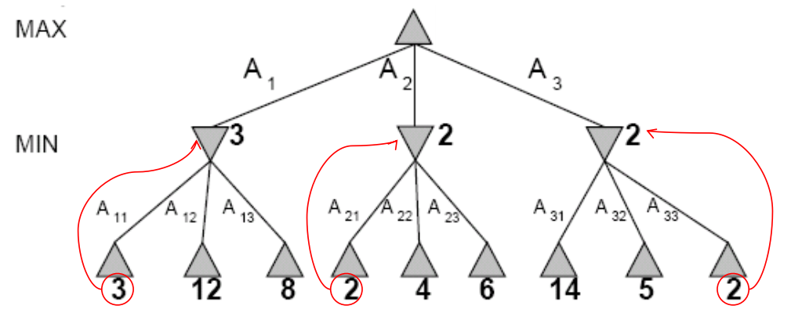
MiniMax Search

Slide 8
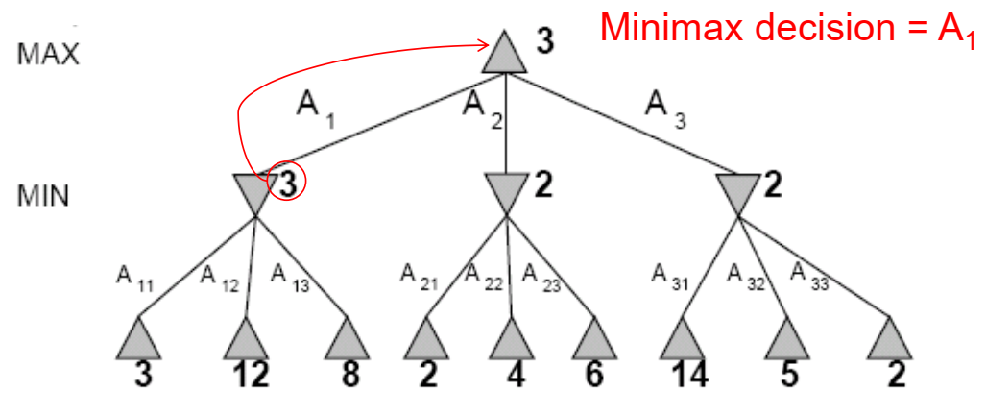
MiniMax Search

Slide 9
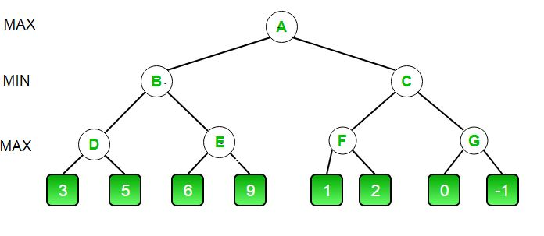
Exercise
Apply MiniMax algorithm on the following example.

Slide 10
Alpha Beta Pruning

Slide 11
Alpha Beta Pruning
Alpha Beta Pruning optimizes decision-making in the minimax algorithm by reducing unnecessary node visits.
The word ‘pruning’ means cutting down branches and leaves. In Artificial Intelligence, Alpha-beta pruning is the pruning of useless branches in minimax tree.
The key idea behind Alpha Beta Pruning is to avoid evaluating branches of the game tree that cannot influence the final decision based on the values already discovered during the search.
It achieves this using two values: Alpha and Beta.

Slide 12
Alpha Beta Pruning
Alpha represents the best (highest-value) value that the maximizing player (usually the AI) can guarantee so far. The initial value of alpha is −∞.
Beta represents the best (lowest-value) value that the minimizing player (the opponent) can guarantee so far. The initial value of alpha is +∞.
If, at any point, Alpha becomes greater than or equal to Beta, this branch is pruned, and the algorithm moves on to the next branch.
This process allows the algorithm to skip large parts of the tree, significantly reducing the number of nodes to be evaluated.

Slide 13
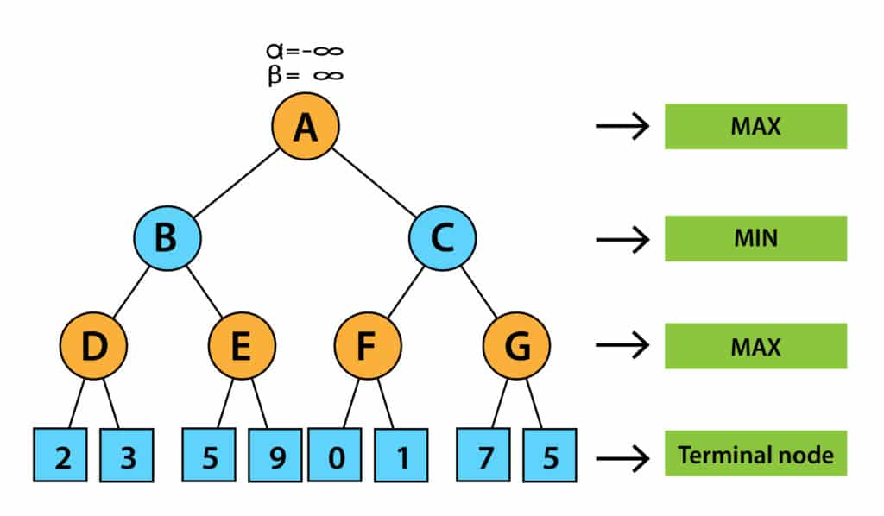
Alpha Beta Pruning Example
Initially, we will define α = −∞ and β = +∞.

Slide 14
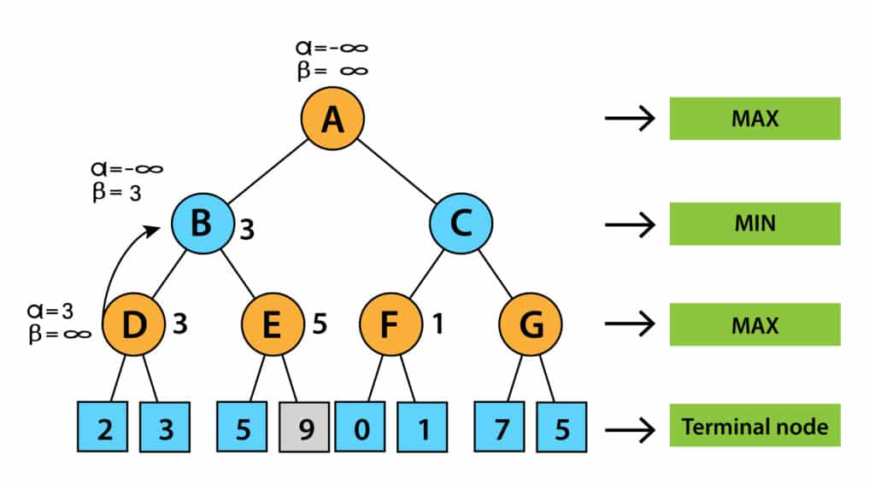
Alpha Beta Pruning Example
Now it’s turn for MAX. Therefore, we will calculate the value of alpha at node D. At node D, the value of alpha will be MAX (– ∞, 2) = 2 and then MAX (2, 3) = 3.
Now, node B’s turn is MIN. It means that the value of beta at node B will be MIN (3, ∞). Therefore, alpha will be – ∞ and beta will be 3 at node B.

Slide 15
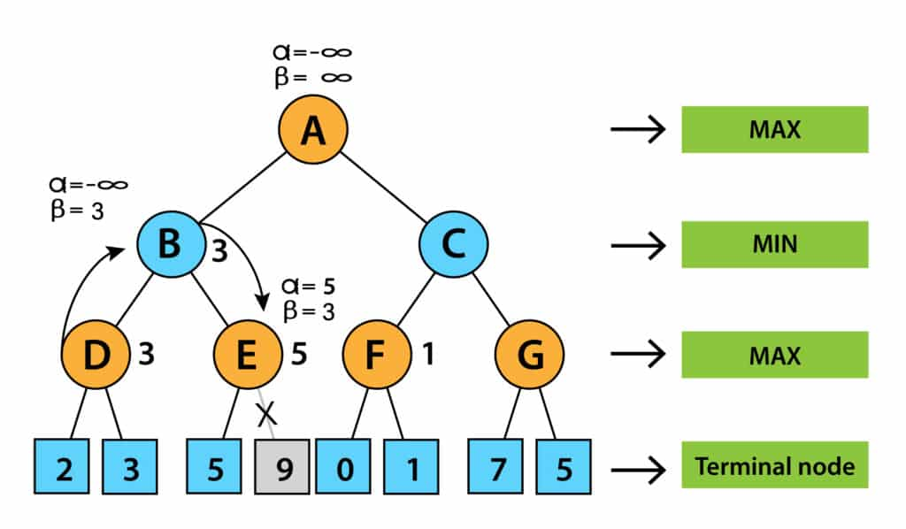
Alpha Beta Pruning Example
Next, algorithm will pass the values of α= -∞ and β= 3 to the next successor of Node B, that is node E.
Now it’s turn for MAX. Therefore, we will search for MAX at node E. The value of alpha at E is – ∞ and will be compared with 5. So, MAX (- ∞, 5) will be 5. Thus, at node E, alpha = 5, Beta = 3.
We now know that alpha is greater than beta and is also a pruning condition, so we can prune the right successor of node E, and the algorithm will not be visited, and the value of node E will be 5.

Slide 16
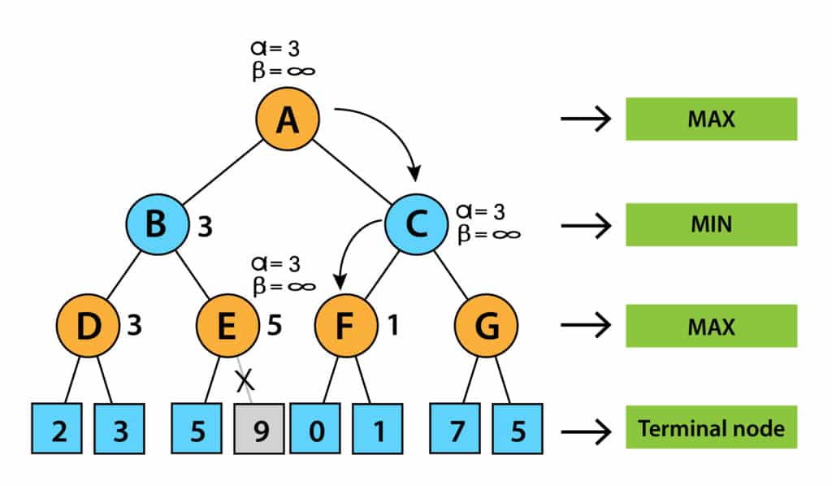
Alpha Beta Pruning Example
In the next step, the algorithm again comes from node B to node A. The alpha of node A is changed to the max value of MAX(- ∞, 3). Now, alpha and beta at node A are (3, + ∞) and will be transmitted to node C. The same values will be transferred to node F.
The value of alpha will be compared to the left branch, which is 0 at node F. Now, MAX (0, 3) will be 3 and is compared with the right child (1) and MAX(3, 1) = 3 still α is 3, but the node value of F will be 1.

Slide 17
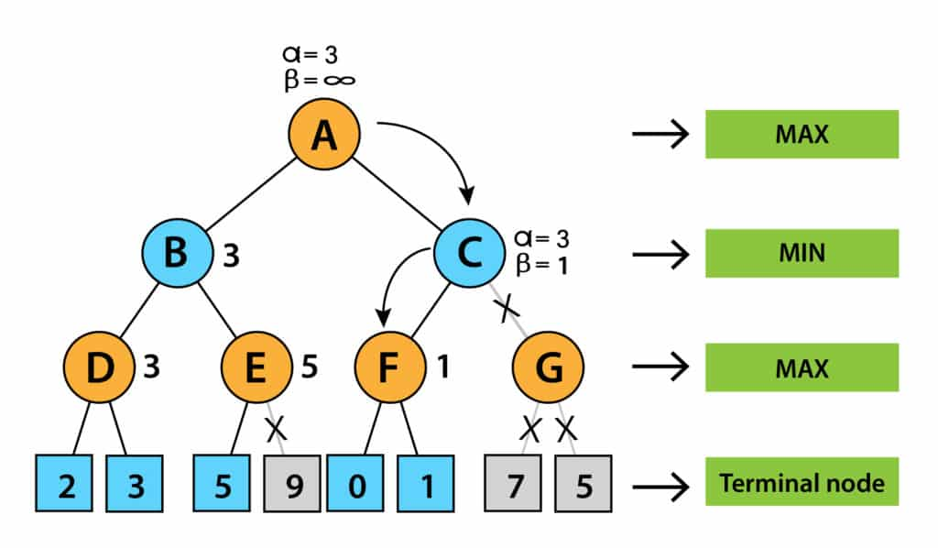
Alpha Beta Pruning Example
The node F will pass the node value 1 to C and compare it to the beta value at C. Now it’s turn for MIN. So, MIN (+ ∞, 1) will be 1.
Now, at node C, α = 3, β= 1, and alpha is greater than beta, which again satisfies the pruning condition. Then, the right successor of node C, G, will be pruned, and the algorithm did not calculate the whole subtree G.

Slide 18
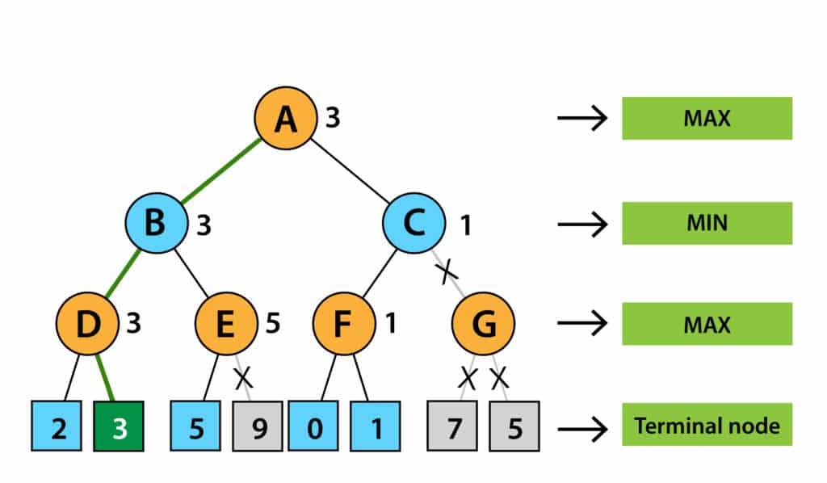
Alpha Beta Pruning Example
Now, C will return its node value to A, and A will calculate MAX(1, 3), resulting in 3.
This above-represented tree is the final tree that has nodes that are computed and nodes that are not computed. Therefore, in this example, the optimal value of the maximizer would be 3.

Slide 19
Exercise
Apply Aplha Beta on the following example.

Slide 20
Today’s Lecture
MiniMax Algorithm
Alpha Beta Pruning

